Slide 1
Welcome!
Sunday
Bible Study 9:30 AM
Worship 10:30 AM
Wednesday
Bible Class 7:00 PM
www.SunsetchurchofChrist.net

Slide 2
John 8:21-30
Jesus reveals His goal
Belief in Jesus
Speaking from the Father

Slide 3
Welcome!
Sunday
Bible Study 9:30 AM
Worship 10:30 AM
Wednesday
Bible Class 7:00 PM
www.SunsetchurchofChrist.net

Slide 4
Opening Prayer
Song – | Grant Haines
Scripture Reading
Song – | Grant Haines
Song – | Grant Haines
Lord’s Supper
Song – | Grant Haines
Collection
Song – | Grant Haines
Lesson | Brian Haines
Song – | Grant Haines
Closing

Slide 5
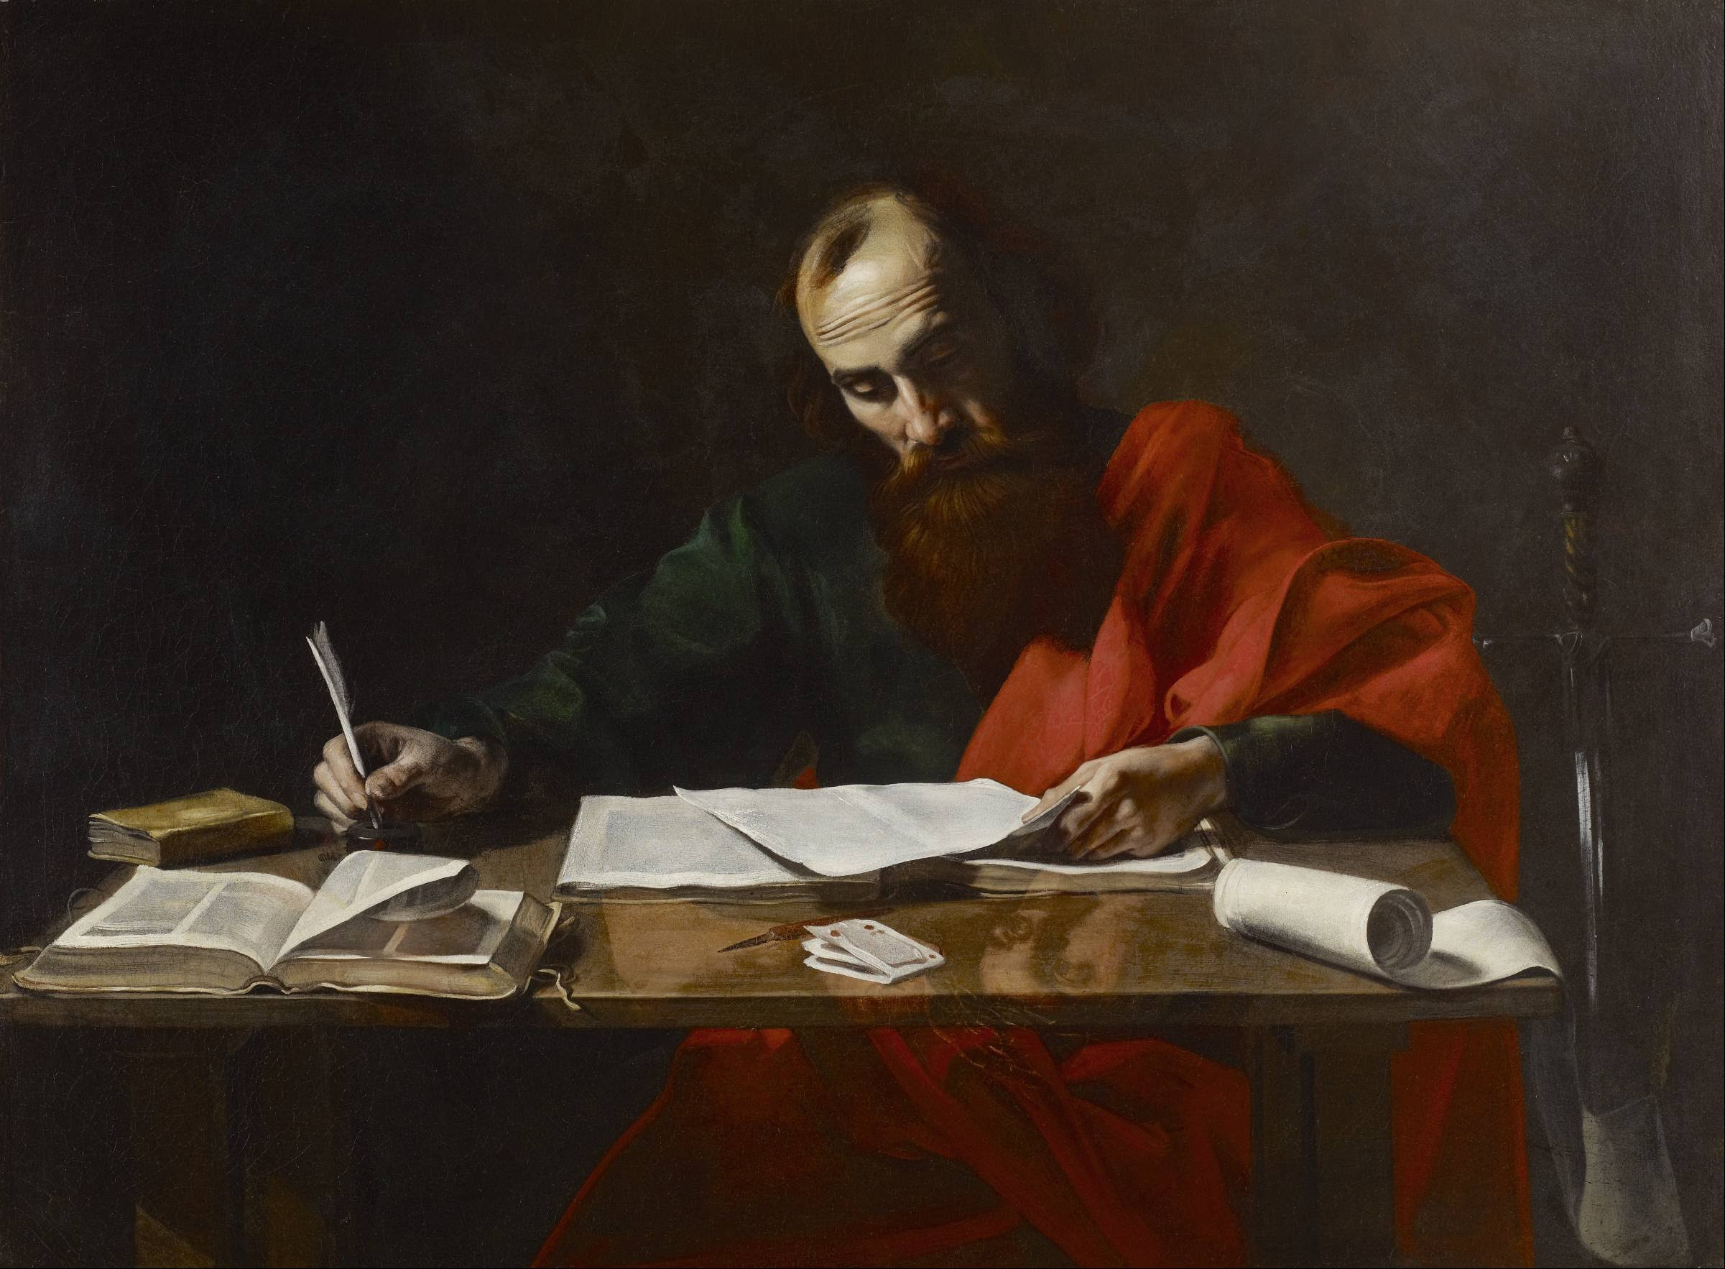
Paul’s Corinthian Advice
1 Corinthians 1
The Plea for Unity
Notes:
Begin reading at vs. 15

Slide 6
The Issue: Division
Formation of parties
Denominations: from the name
Paul
Peter
Apollos
Christ

Slide 7
The Issue: Division
Formation of parties
Denominations: from the name
Two kinds of wisdom
From God or from the world

Slide 8
The Issue: Division
But if you have bitter envy and self-seeking in your hearts, do not boast and lie against the truth. This wisdom does not descend from above, but is earthly, sensual, demonic. For where envy and self-seeking exist, confusion and every evil thing are there. James 3:14-16

Slide 9
The Issue: Division
Formation of parties
Denominations: from the name
Two kinds of wisdom
From God or from the world
Christ, Paul, Peter, Apollos were united

Slide 10
The Issue: Division
What causes division?
Envy and self-seeking – James 3:14-16
Carnal minded – 1 Corinthians 3:3
Caught up in our own interests
Immaturity
Notes:
1Co 3:3 for you are still carnal. For where there are envy, strife, and divisions among you, are you not carnal and behaving like mere men?

Slide 11
The Issue: Division
What causes division?
Envy and self-seeking – James 3:14-16
Fault-finders and grumblers – Jude 16-19
Contending for the faith or contentious?
Looking for error
Believe all things – 1 Corinthians 13
Notes:
Jude 1:16 These are grumblers, finding fault, following after their own lusts; they speak arrogantly, flattering people for the sake of gaining an advantage. 17 But you, beloved, ought to remember the words that were spoken beforehand by the apostles of our Lord Jesus Christ, 18 that they were saying to you, "In the last time there will be mockers, following after their own ungodly lusts." 19 These are the ones who cause divisions, worldly-minded, devoid of the Spirit.

Slide 12
The Issue: Division
What causes division?
Envy and self-seeking – James 3:14-16
Fault-finders and grumblers – Jude 16-19
Foolish disputes – Titus 3:9-10
Unresolvable issues
Matters of opinion and liberty

Slide 13
The Solution: Unity
But God composed the body, having given greater honor to that part which lacks it, that there should be no schism in the body, but that the members should have the same care for one another 1 Corinthians 12:24b-25

Slide 14
The Solution: Unity
What establishes unity?
Love for brethren – 1 Corinthians 12:24-25
Putting others above ourselves
Being sacrificial in all things
Patience!
Notes:
1 Co 8:1 Now concerning things offered to idols: We know that we all have knowledge. Knowledge puffs up, but love edifies.

Slide 15
The Solution: Unity
What establishes unity?
Love for brethren – 1 Corinthians 12:24-25
Love for the Truth – John 17:17-23
Doctrine is Truth
No unity without doctrine – 2 John 9
Notes:
Joh 17:17 ¶ "Sanctify them by Your truth. Your word is truth. 18 "As You sent Me into the world, I also have sent them into the world. 19 "And for their sakes I sanctify Myself, that they also may be sanctified by the truth. 20 ¶ "I do not pray for these alone, but also for those who will believe in Me through their word; 21 "that they all may be one, as You, Father, are in Me, and I in You; that they also may be one in Us, that the world may believe that You sent Me. 22 "And the glory which You gave Me I have given them, that they may be one just as We are one: Joh 17:23 "I in them, and You in Me; that they may be made perfect in one, and that the world may know that You have sent Me, and have loved them as You have loved Me.
2Th 2:10 and with all unrighteous deception among those who perish, because they did not receive the love of the truth, that they might be saved.

Slide 16
Pursuing Unity
There is no unity with love alone
Unity must have agreement – Amos 3:3
There is no unity without agreement
The plea of unity – 2 Timothy 3:16-17
Notes:
Am 3:3 Can two walk together, unless they are agreed?

Slide 17
Pursuing Unity
There is no unity with love alone
There is no unity with doctrine alone
There is no such thing as 100%
Patience, love and teaching

Slide 18
Pursuing Unity
There is no unity with love alone
There is no unity with doctrine alone
There is no unity without YOU

Slide 19
Pursuing Unity
Therefore let us pursue the things which make for peace and the things by which one may edify another. Romans 14:19

